Slide 1





Vesuvius Challenge
Ink Detection
By: Rom Gat
ID: 206395253

Slide 2
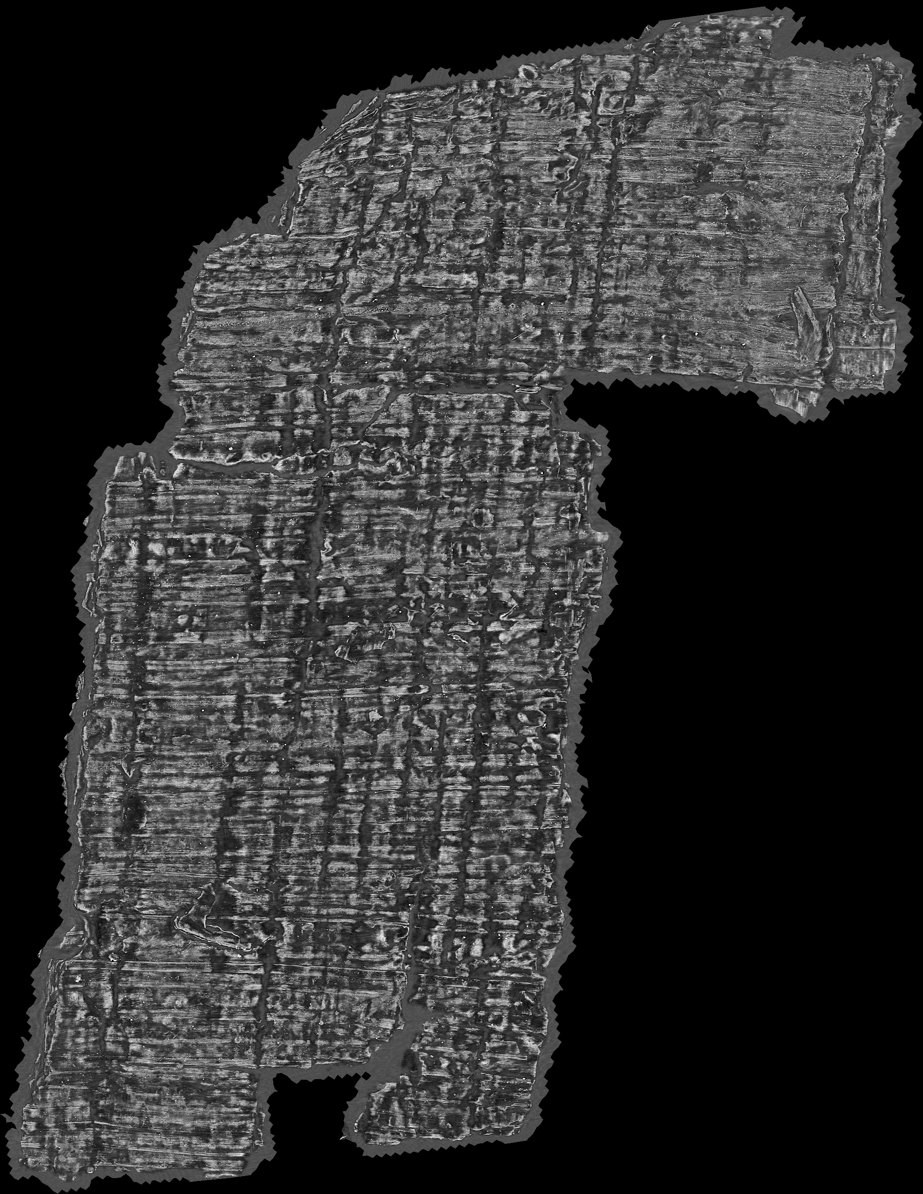
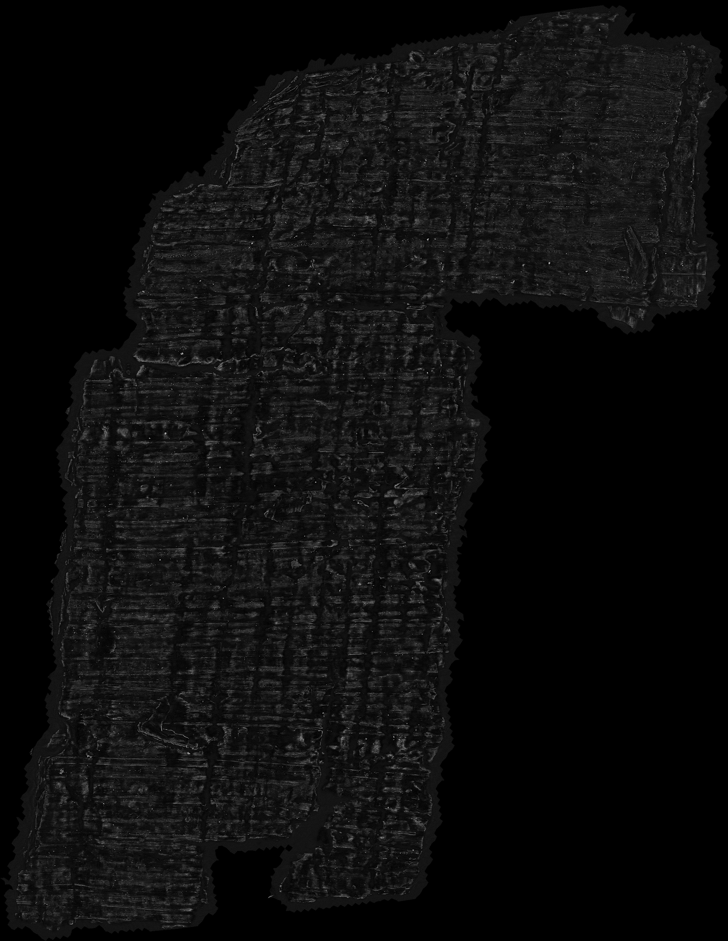
Competition Summary:
About 300 years ago, some scrolls belonging to a villa in Herculaneum were discovered.
Due to the Vesuvius eruption, these scrolls became carbonized, hence they cannot be opened without risking breaking them.
Many scrolls were destroyed this way, and only a few revealed ink on their broken surface, visible under Infra-Red light.
It was found that 3D X-Ray scans contain data which Machine Learning models can use to detect ink, even though the human eye cannot see it.
You are given X-Ray scans (Features) and IR-Imaging (Ground-Truth) of broken fragments which contain ink, and are tasked with training models to detect the ink from the scans alone.

Slide 3
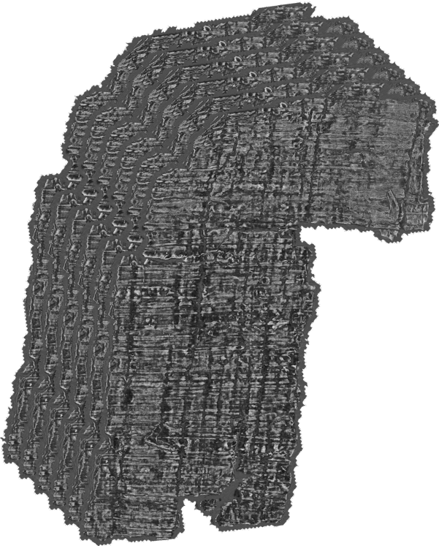
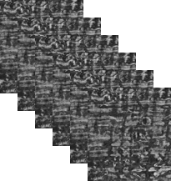

Solution Summary:
Use only 6 slices from the total 65 of the X-Ray scan.
Divide the 3D images into small pieces (Chunks), with overlap.
1/2 for training, 7/8 for inference.
Use architectures based on segmentation models to detect the ink from the scans.
Mainly Unet + ResNeXt50 32x4d.
Ensembles, Meta-Models, Stacked Models.
Use Test-Time Augmentations (TTA).
Segmentation Model
Test-Time Augmentation

Slide 4
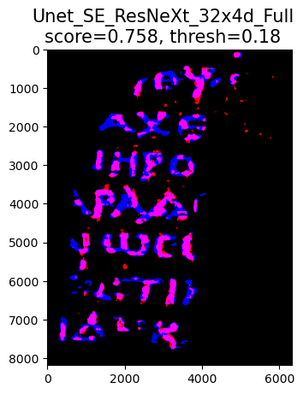
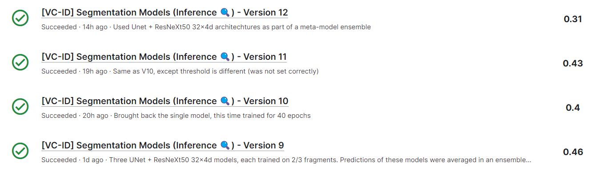
Results:
This is the result of a single model, trained for 40 epochs on all data, and inferenced on the 1st fragment.
(The best result achieved looks very similar this)

Slide 5



Based On:
2.5d segmentaion baseline [training]
2.5d segmentaion model with rotate TTA
lb0.68 one-fold, stacked Unet
tk
yoyobar
hengck23

Slide 6
Modifications:
Training Code Optimization
Weighted Loss, Masked Loss
Single Model, Meta-Model, Stacked Multi-Model

Slide 7
Training Code Optimization:
The code featured in the training notebook utilized GPU for forward and back-propagation, but not for metric calculation.
This resulted in slower training sessions – About 25 minutes per epoch for a basic model.
By optimizing the code, I was able to speed up the training process to be 5 times faster (After adding more metric calculations).
This involved changing code to be based on Pytorch instead of Numpy, altering calculations to be memory efficient, frequent memory cleaning and more…

Slide 8
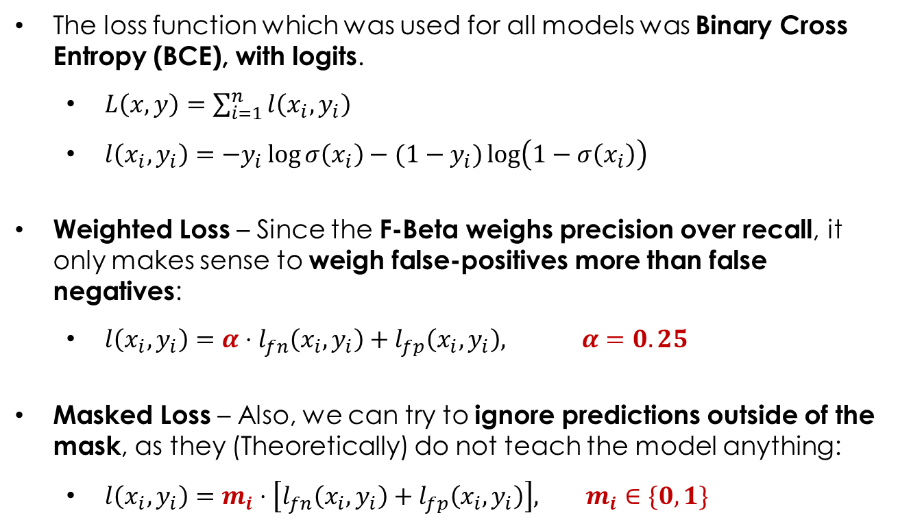
Altering the Loss Function:
The loss function which was used for all models was Binary Cross Entropy (BCE), with logits.
$L\left(x,y\right)=\sum_{i=1}^{n}{l\left(x_{i},y_{i}\right)}$
$l\left(x_{i},y_{i}\right)=−y_{i}\log{σ\left(x_{i}\right)}−{(1−y}_{i})\log\left(1−σ\left(x_{i}\right)\right)$
Weighted Loss – Since the F-Beta weighs precision over recall, it only makes sense to weigh false-positives more than false negatives:
$l\left(x_{i},y_{i}\right)=α⋅l_{fn}\left(x_{i},y_{i}\right)+l_{fp}\left(x_{i},y_{i}\right), α=0.25$
Masked Loss – Also, we can try to ignore predictions outside of the mask, as they (Theoretically) do not teach the model anything:
$l\left(x_{i},y_{i}\right)=m_{i}⋅\left[l_{fn}\left(x_{i},y_{i}\right)+l_{fp}\left(x_{i},y_{i}\right)\right], m_{i}∈\{0,1\}$
Worked!
Didn’t Work…

Slide 9
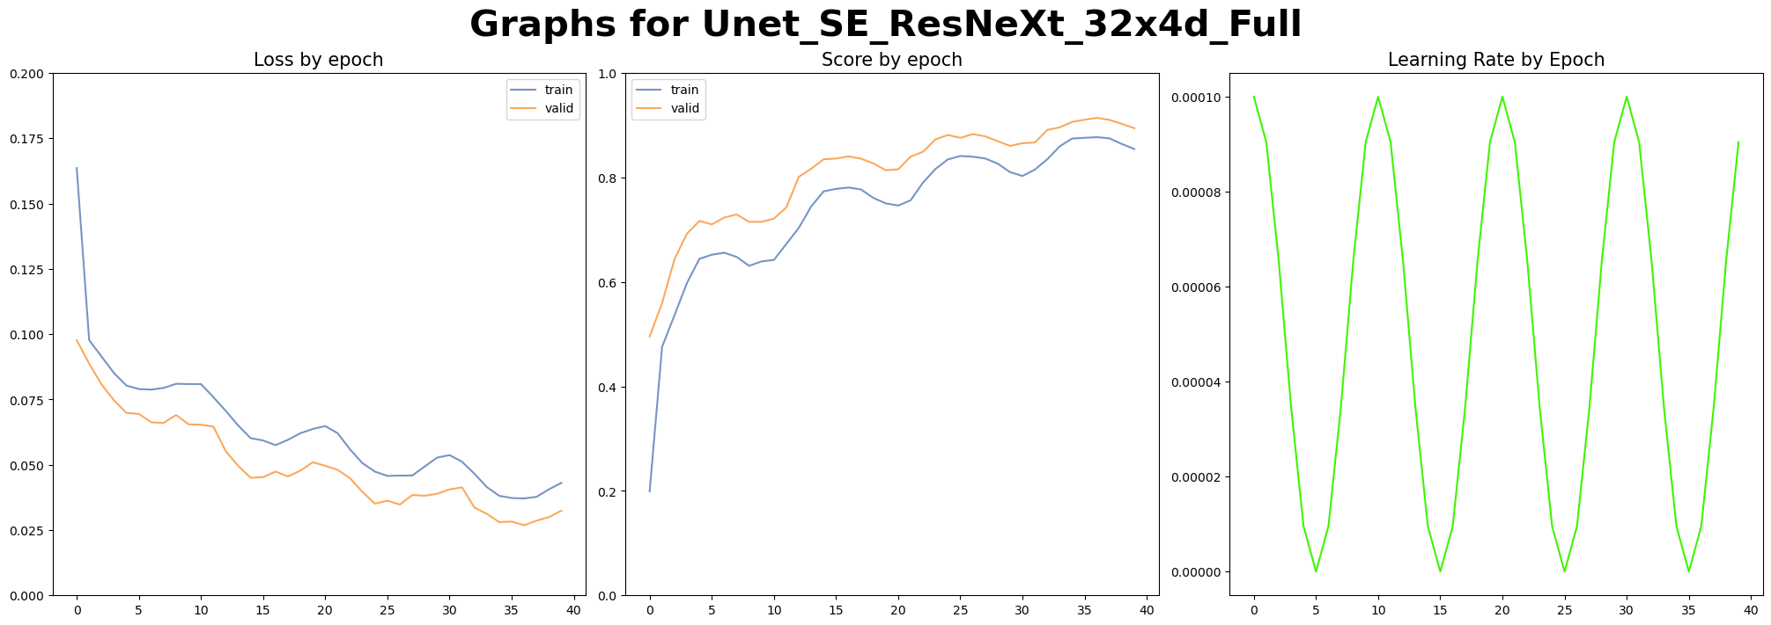
Complex Models:
The original first 2 notebooks trained a model per fold, meaning that each model trained on two fragments and was validated on the third. These models were combined into a bagging ensemble.
Initially, I tried to replace the ensemble with a single segmentation model, which trained on all data. It was trained for 40 epochs and achieved a score of 0.43.

Slide 10
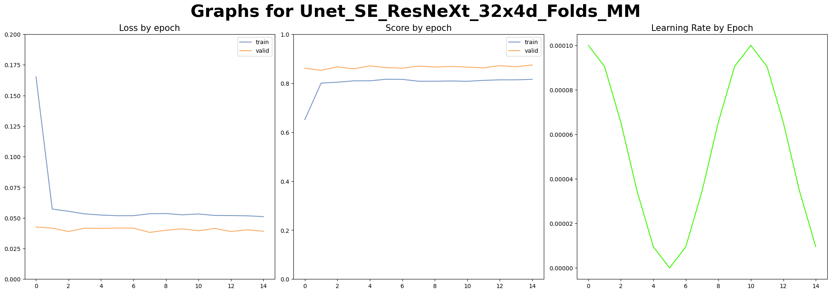
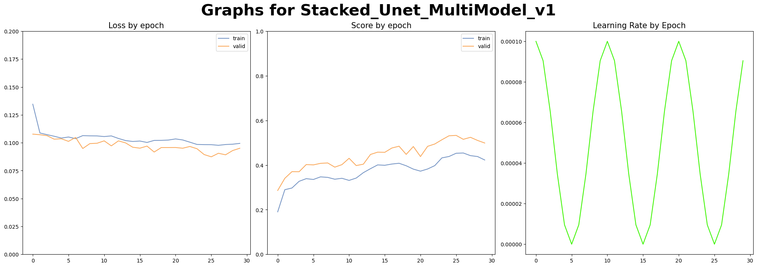
Complex Models:
I also tried to replicate the original score by repeating the original training process – The ensemble achieved a score of 0.46.
Finally, I tried techniques such as stacking ensemble using a segmentation model as a meta-model and stacking multiple models (Two models made predictions and passed them onto a third “head” model).

Slide 11
What did I Learn:
Constant code reviews and testing were vital to this project (Would have saved a lot of time).
In Machine Learning, it is better to start with small modifications of working code, rather than add a bunch of features and hope they work.
Topics in Computer Vision: Working with GPU, various segmentation models, TTA.

Slide 12
Questions?

Slide 13
Thank you for listening!

